Slide 1
Car Explorer C#

Slide 2
Team Members
Przemyslaw K. Cichy -40%
Ali Sha’ath -30%
Stuart Leighton -30%

Slide 3
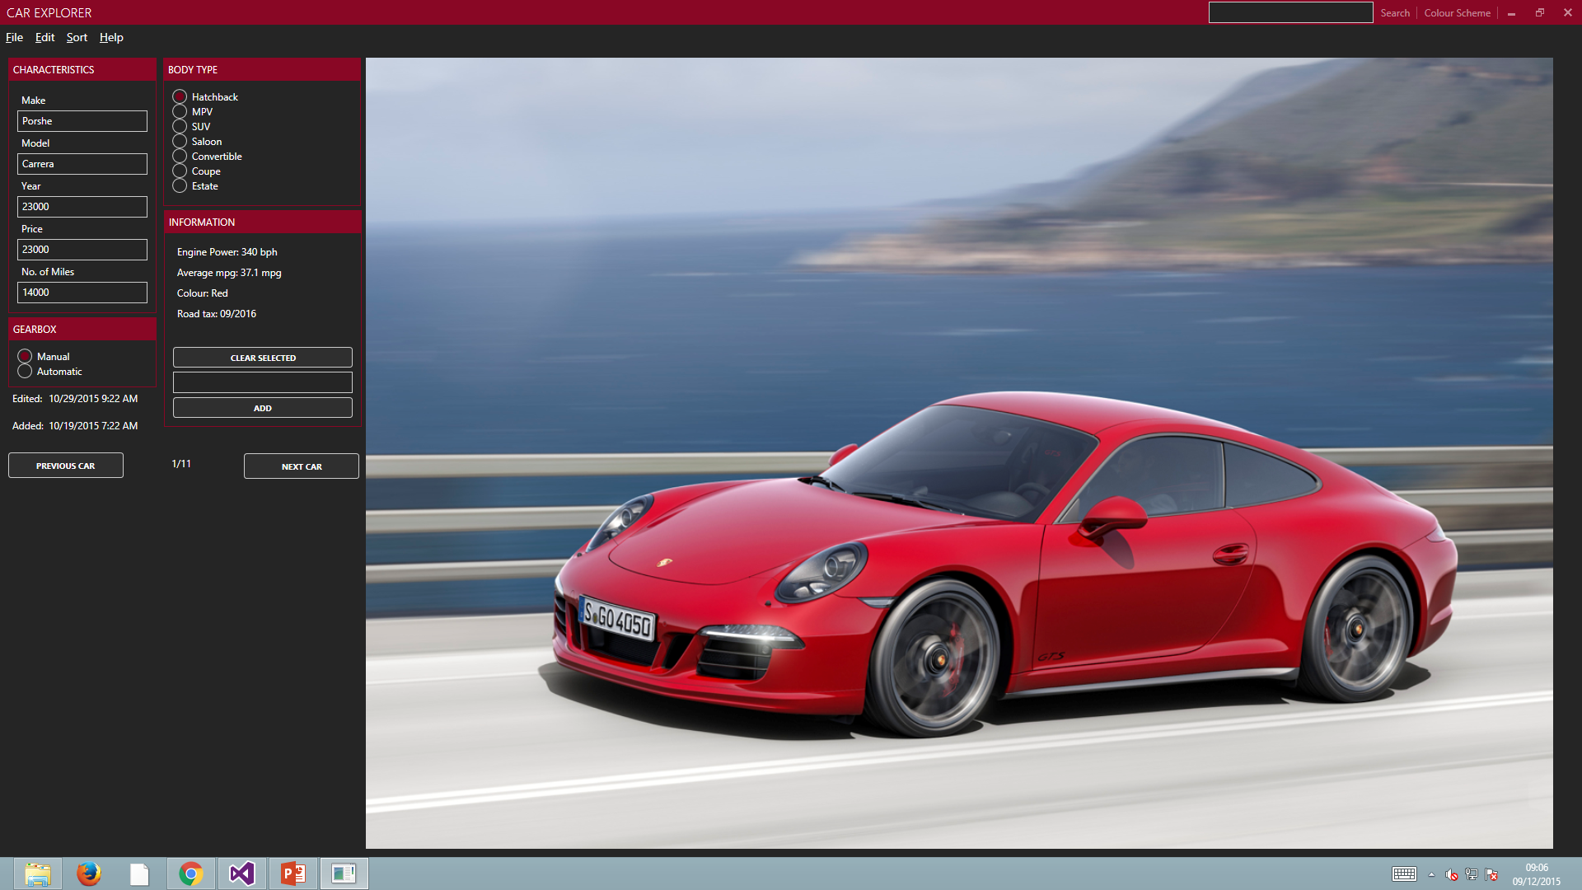
This is the App.
Fully Functional.
Notes:
The purpose of this app is to allow user to manage a database of cars.
This is an example of a car view.

Slide 4
Feautures
1
Let’s start with the first set of slides

Slide 5
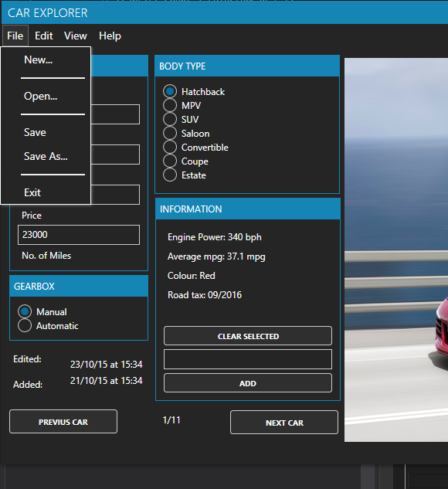
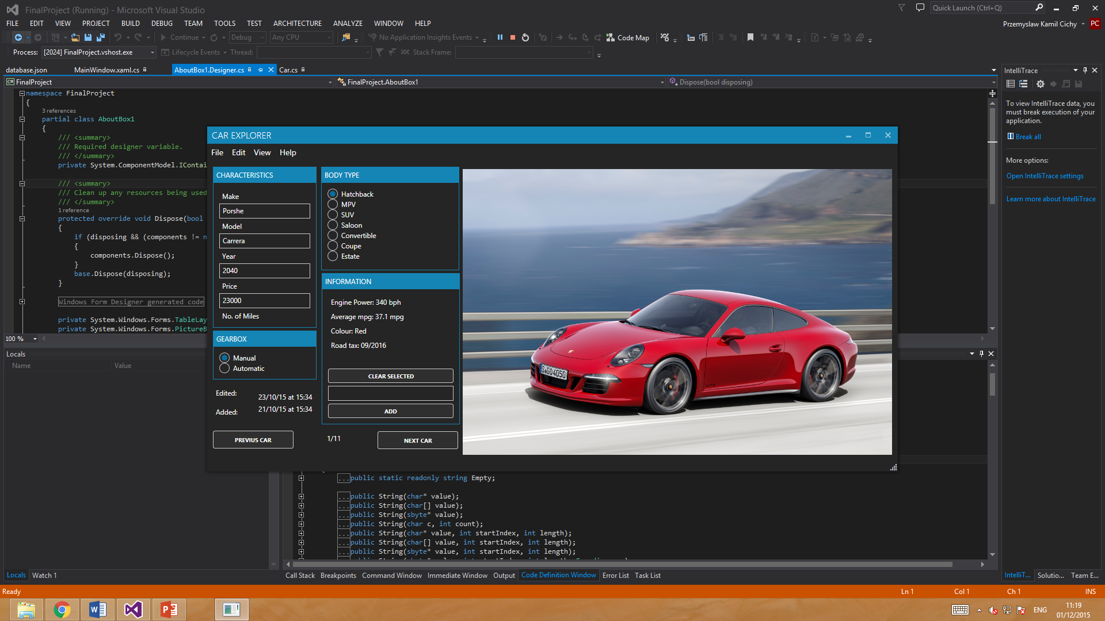
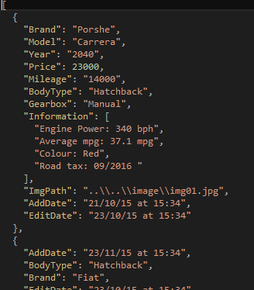
Database file Manipulation
Open json file
Save json file
Save as json file
Create new file
Notes:
App can open/save different json files
User can have different files, like company car lists, family cars and so on

Slide 6
Open/Save/SaveAs
CarList
Open
Save
Save as
Json File
Notes:
Deserialize / serialize

Slide 7
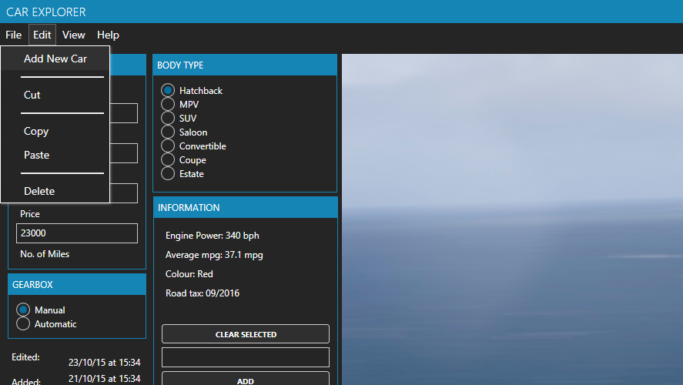
Edit Car
Add new car
Cut a car
Copy a car
Delete a car

Slide 8
Copy/Cut/Pasting/
Cut
tempCar
New
Paste
Copy
CarList
Delete

Slide 9

Sorting Cars
Sort by
Brand
Year
Price
Filter
Year
Price

Slide 10
Sorting
SortedCarList
Sorting Option
Year
Price
Brand
Filtering
Brand
Price
Year
CarList

Slide 11
Responsive Modern Layout
Size of the window
WPF Application
XAML Components
Colour Scheme of the window with MahApps by Paul Jenkins for Metro-style in WPF application.

Slide 12
Displaying
Databinding
Next/previous
File menu operations
Edit menu operations
View Menu Operations
View
User View
CarList

Slide 13
Demonstration
1
Let’s start the demonstration

Slide 14
Car Explorer
Fully working, nicely designed, user friendly.

Slide 15
Conclusion and Evaluation
1
Let’s start with the last set of slides

Slide 16
Improvements
More responsive, layout – Arranging containers on the screen based on resolution.
Allow user to add more than 1 picture for each Car.
Slideshow for pictures.
More Colour schemes.
Smartphone/Tablet App.
Pictures diretly from web URL.

Slide 17
Evaluation
Overall the application meets our designing goals.
It is fully functional. It has friendly user layout.
It provides user with feedback to what effect his action have.
Due to use of XAML, its cross platform.
Only the view + initialization need to be modified.

Slide 18
Thanks!
ANY QUESTIONS?
Presentation template by SlidesCarnival

